Slide 1
Watson X Governance
Garrett Young Data & AI Solutions Specialist
sgyoung@us.ibm.com
Notes:
Intro Name
ICA Link :
https://servicesessentials.ibm.com/launchpad/teams/669fad86b38b4d1c2dc2cdec
GRC Link:
https://cpd-cpd-watsonx.watsonxgov-product-918231-c97c2ce0266e6f32de317d52e2a84f46-0000.us-south.containers.appdomain.cloud/openpages-op-wxgov-instance/app/jspview/react/grc/dashboard/Home
Watson X Governance :
https://cpd-cpd-watsonx.watsonxgov-product-918231-c97c2ce0266e6f32de317d52e2a84f46-0000.us-south.containers.appdomain.cloud/wx/home?context=wx
username: cpadmin
password: 05p42dnM5mKXGL9CTgoQ73IGXB6JYMtQ

Slide 2
Agenda
Quick intro

Slide 3
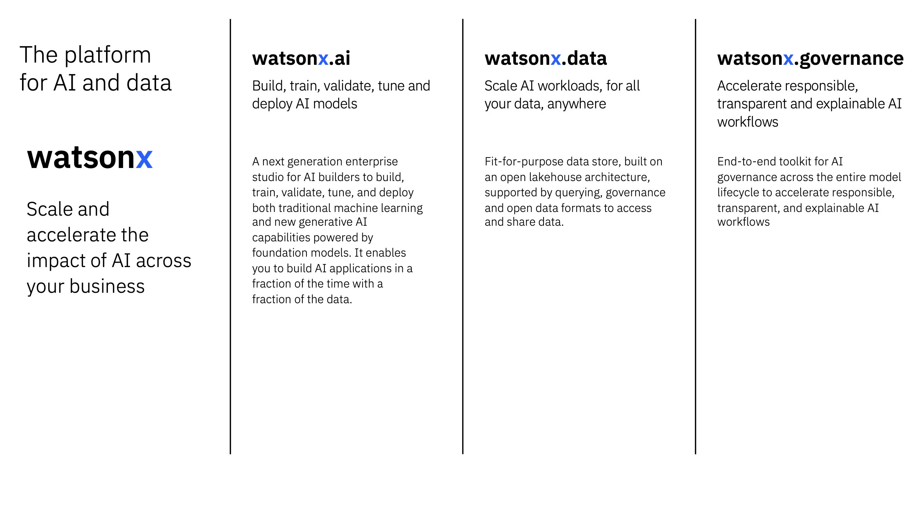
Notes:
There are several Watson X offerings, these are the main 3 that are used for LLMs
The main take away: We are going to show how we use WX gov to collect model governance data that can be propagated to ICA. This shows what the data looks like and some of the capabilities.
Next Slide Setup:
We used 2 components inside WX gov to accomplish this.
Site:
https://cpd-cpd-watsonx.watsonxgov-product-918231-c97c2ce0266e6f32de317d52e2a84f46-0000.us-south.containers.appdomain.cloud/wx/home?context=wx
username: cpadmin
password: 05p42dnM5mKXGL9CTgoQ73IGXB6JYMtQ

Slide 4

Openscale
Analyze your AI with trust and transparency and understand how your AI models make decisions.
Detect and mitigate bias and drift.
Increase the quality and accuracy of your predictions.
Explain transactions and perform what-if analysis.
More granular : Data Scientist / IT
OpenPages
Simplifies data governance, risk management and regulatory compliance (GRC)
Identify, manage, monitor and report on risk and regulatory compliance
Larger view : Managers, IT Directors
Notes:
Let’s talk about Watson X Governances components that we used.
First, open scale. While you can see it does many things, the focus to what we will show is in bold.
Main Point: This is granular, where I would want to be watching my individual models
Second, will show the Openpages capacities, which is a GRC, higher level.
Main point: This gives me a broader view, collections of models, standardized processes, ownership
Together, this gives governance capabilities for a broad audience.
Next Slide Setup:
Here are the things we will show in the “demo”

Slide 5
Openpages CE Solution Key Take Aways:
Models and the Insight Dashboard, where we get a high level view of compliance
Show use cases, where we have collections of model, risks
Workflows and Automated Approval Processes
Operational Efficiency : dev, staging, production
Notes:
Let’s do the demo of Openpages portion
We are moving to the concept of a use case, which can consume many models.
Site:
https://cp-console-cpd-watsonx.watsonxgov-product-918231-c97c2ce0266e6f32de317d52e2a84f46-0000.us-south.containers.appdomain.cloud/oidc/login.jsp
username: cpadmin
password: 05p42dnM5mKXGL9CTgoQ73IGXB6JYMtQ
Demo Notes:
Workflows
- Approval : Monitoring of the use case, POC at the pilot level

Slide 6
Openscale CE Solution Key Take Aways for ICA Models:
Models and the Insight Dashboard
Alerts with Drift and Generative AI Quality
How to adjust metrics for monitoring
Historical governance performance metrics
watsonX Governance AI Factsheets and report generation
Notes:
Let’s do the demo of Openscale
Let’s say I’m a data scientist who wants to see if my model is performing correctly. Here are some things I would do (read slide)
ICA Link:
https://servicesessentials.ibm.com/launchpad/teams/669fad86b38b4d1c2dc2cdec
Watson X Site:
https://cpd-cpd-watsonx.watsonxgov-product-918231-c97c2ce0266e6f32de317d52e2a84f46-0000.us-south.containers.appdomain.cloud/wx/home?context=wx
username: cpadmin
password: 05p42dnM5mKXGL9CTgoQ73IGXB6JYMtQ

Slide 7




watsonx.governance & Apptio Integration
Python Jobs (Notebooks)
Deployment Space (Prod)
Model Health API
Calculations
Price / Regressions
Model 1
Model 2
….
Model X
Token Counts
Storage
Model Information
Model Cost Information Display

Slide 8
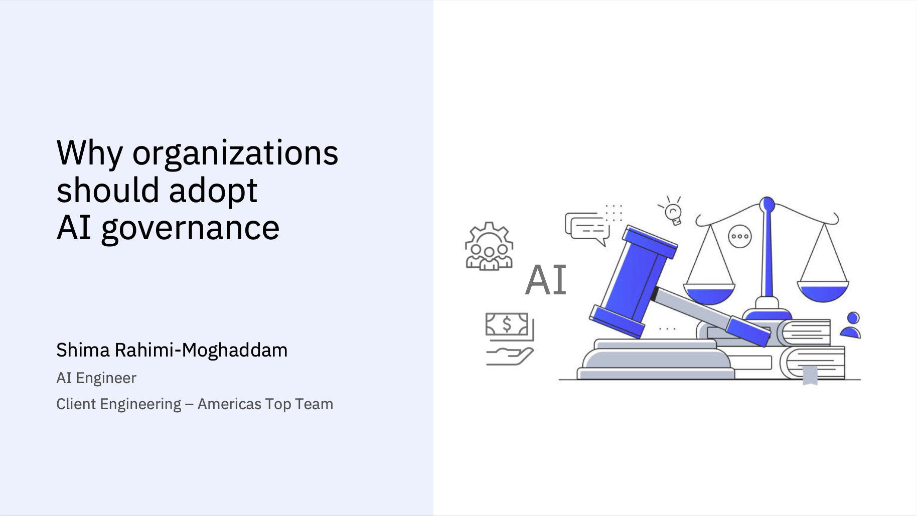
Notes:
Hi My name is Garrett Young, I’m a Technical Solution specialist for Data and AI at IBM.
Today, we are going to show the features of the AI governance solution the Client engineering team put together.
I will start with a presentation highlighting the concepts we will be showing.
Keep in mind, these are just some of the concepts and there is much more to our solution.
*** Next Slide Setup:
Let’s start by talking about why AI governance is important…. *click*

Slide 9
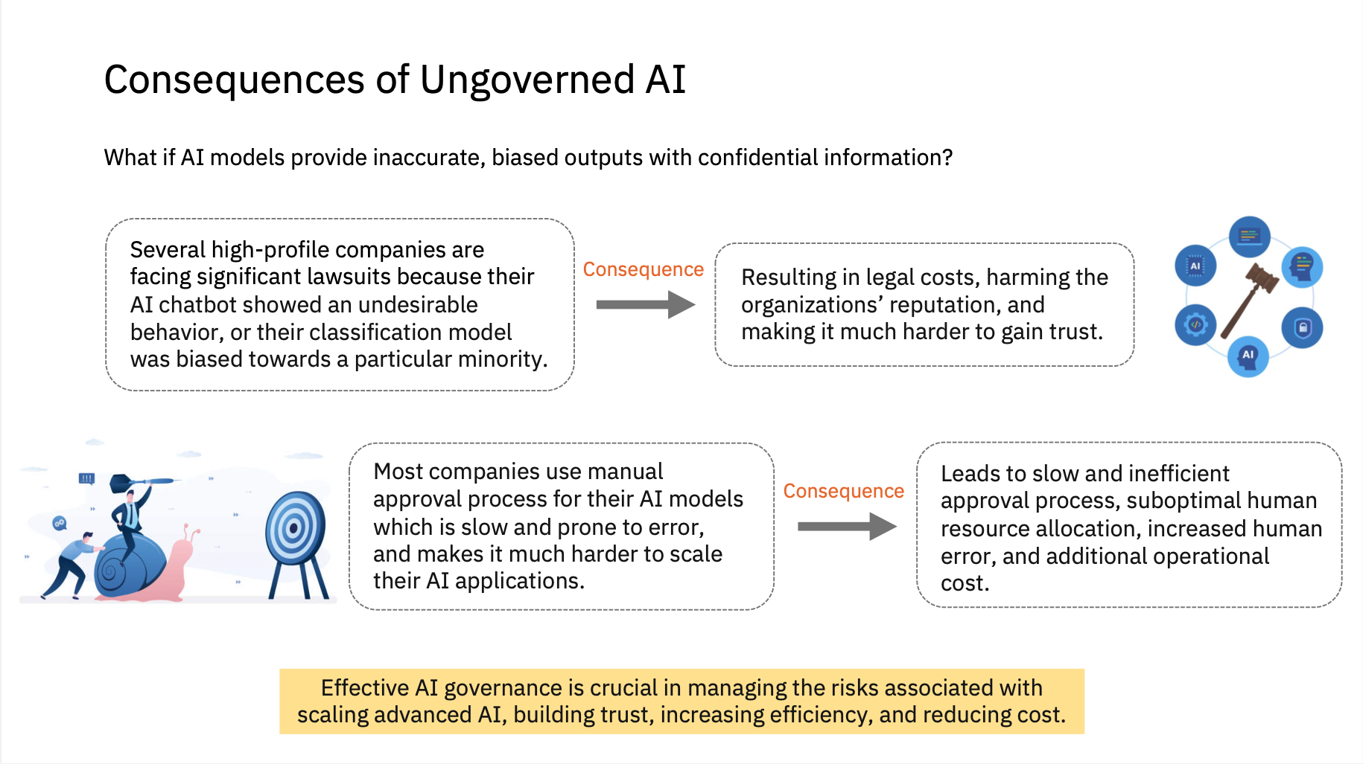
Notes:
If your models are not governed, such as bias, they can have undesirable behavior. You can see the consequences of this: Lawsuits, organizations reputation, or even your teams reputation internally.
A second issue is speed to delivery, affecting ROI. Manual approvals can slow down deployments.
I want to emphasize two points, which will be shown in the demo, a solution for:
- Monitoring models
Manual Approval Process
*** Next Slide Setup:
AI Governance can be broken up into 3 pillars, which we address in the solution. *** click ***

Slide 10
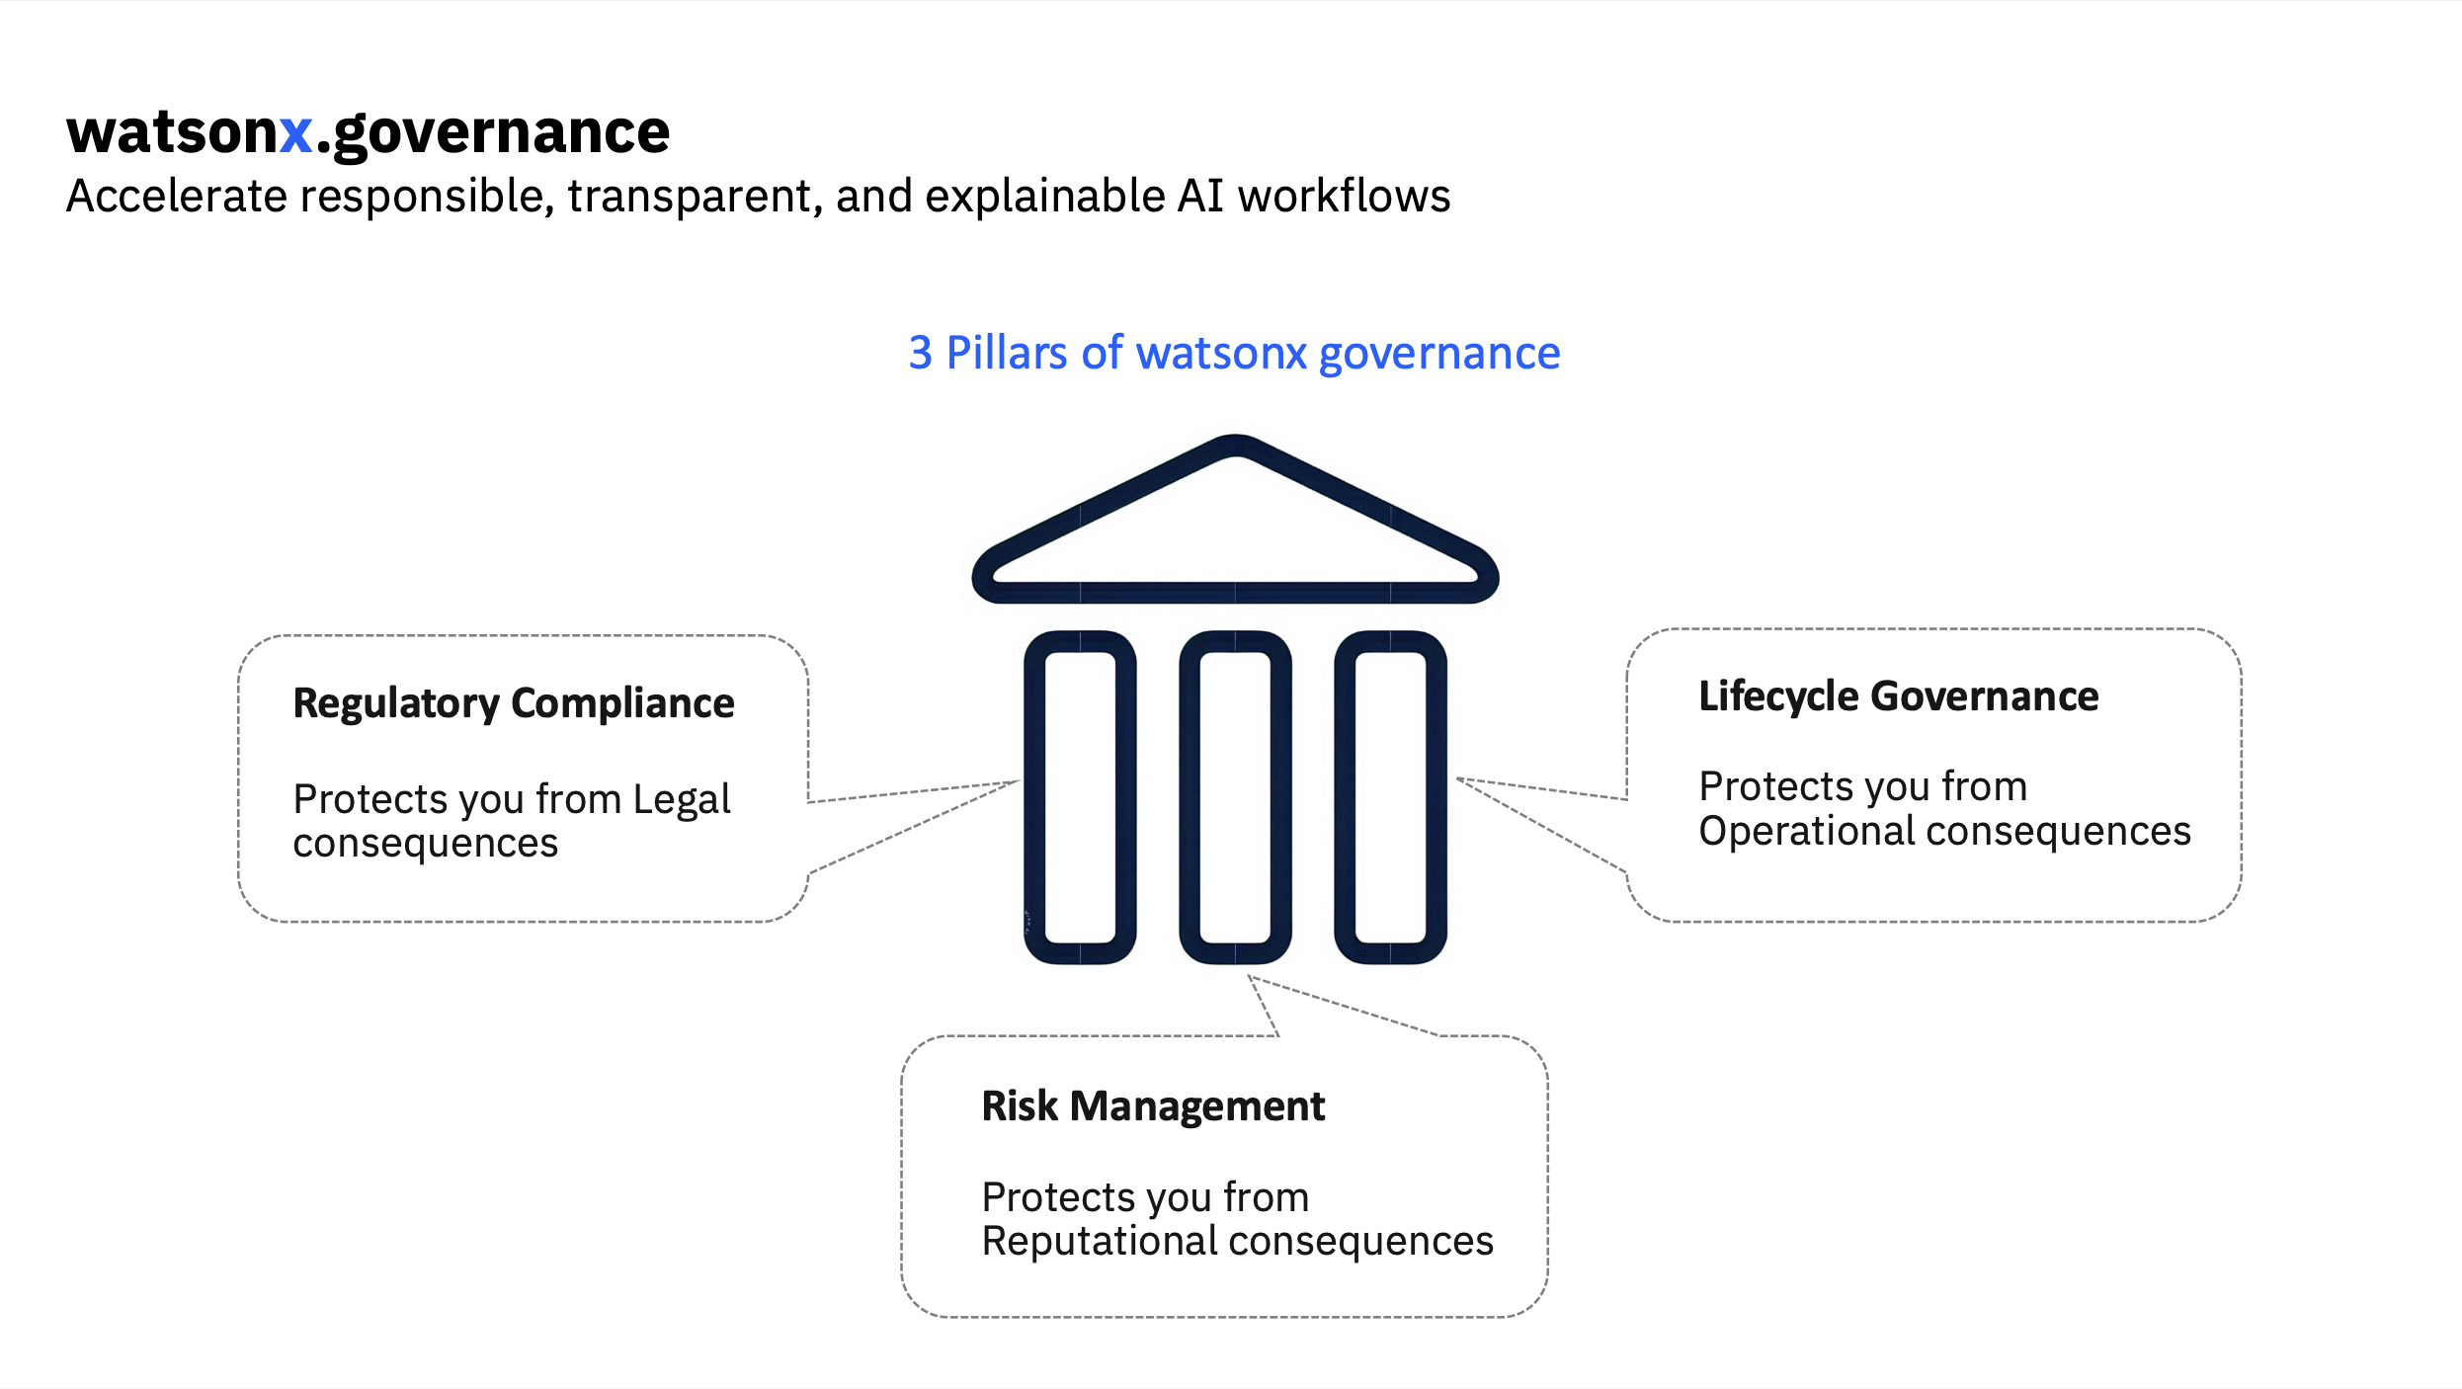
Notes:
The three pillars of governance are regulatory compliance, risk management and lifecycle governance.
The solution will show how AI use cases can be logically organized with certain regulatory compliance in mind.
In the demo you will also see how models can be monitored for performance and bias, protecting you from reputational consequences, which is part of Risk Management.
Finally, we will show lifecycle governance, which is the idea of graduating your AI assets to the right phase when appropriate. You will see an example of this in the demo.
*** Next Slide Setup:
Let’s talk about each pillar a little more …

Slide 11
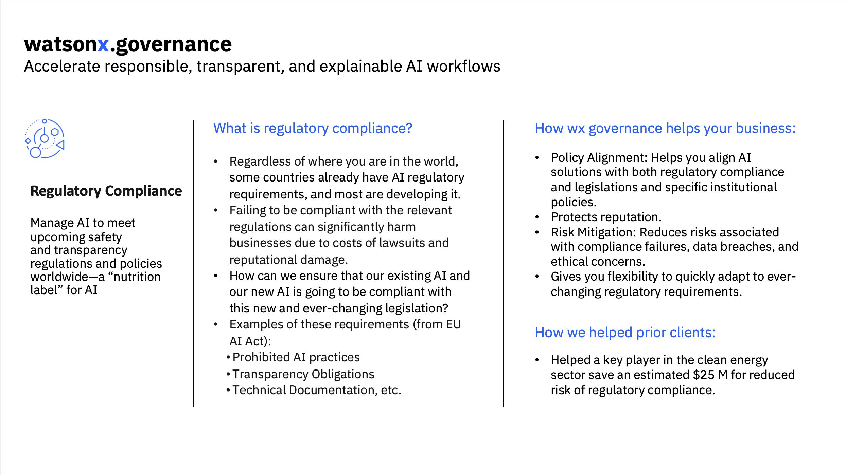
Notes:
Let’s talk about Regulatory Compliance.
You may already have compliance standards created by goverments or other entities.
More details are in the chart, but the Emphasis on our solution is in the top right:
- We want to make sure our existing AI is compliant now and in the future with changing Legislation
*** Next Slide Setup:
The second topic we will quickly discuss is risk management… *click*

Slide 12
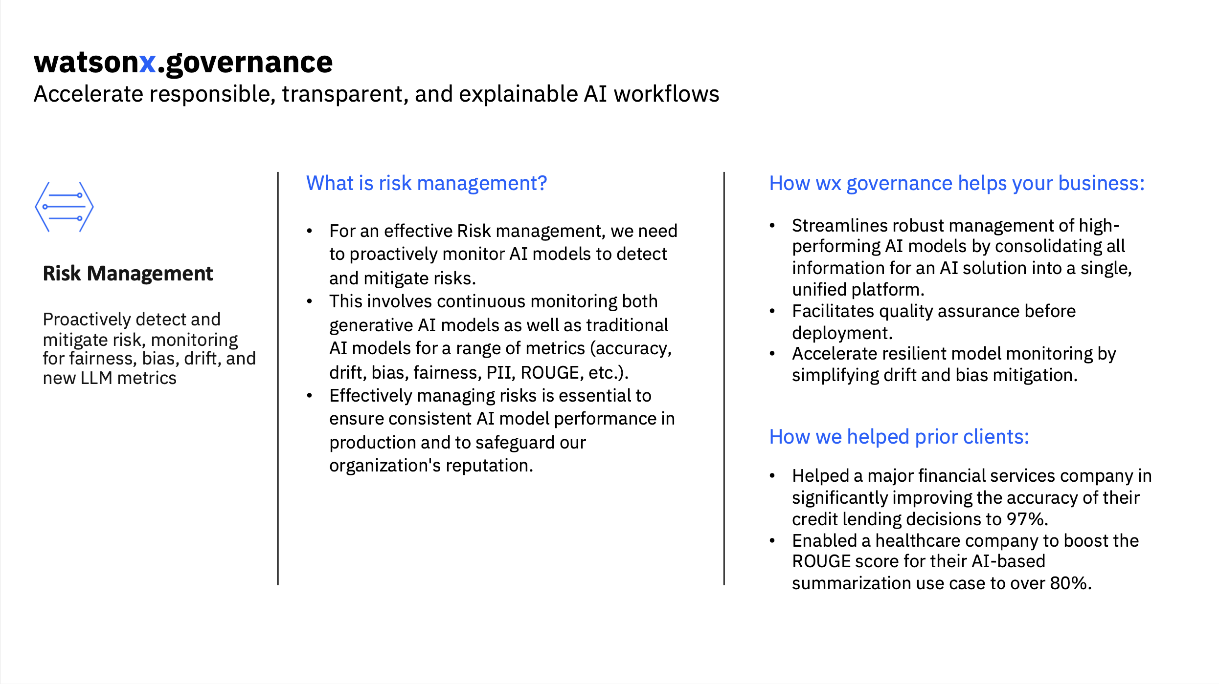
Notes:
In Risk management, the takeaway is monitoring your models for bias, drift, and the data they provide.
This protects your organizations reputation. We will show this in the demo when we show model metrics.
*** Next Slide Setup:
Next, we will discuss model lifecycles.

Slide 13
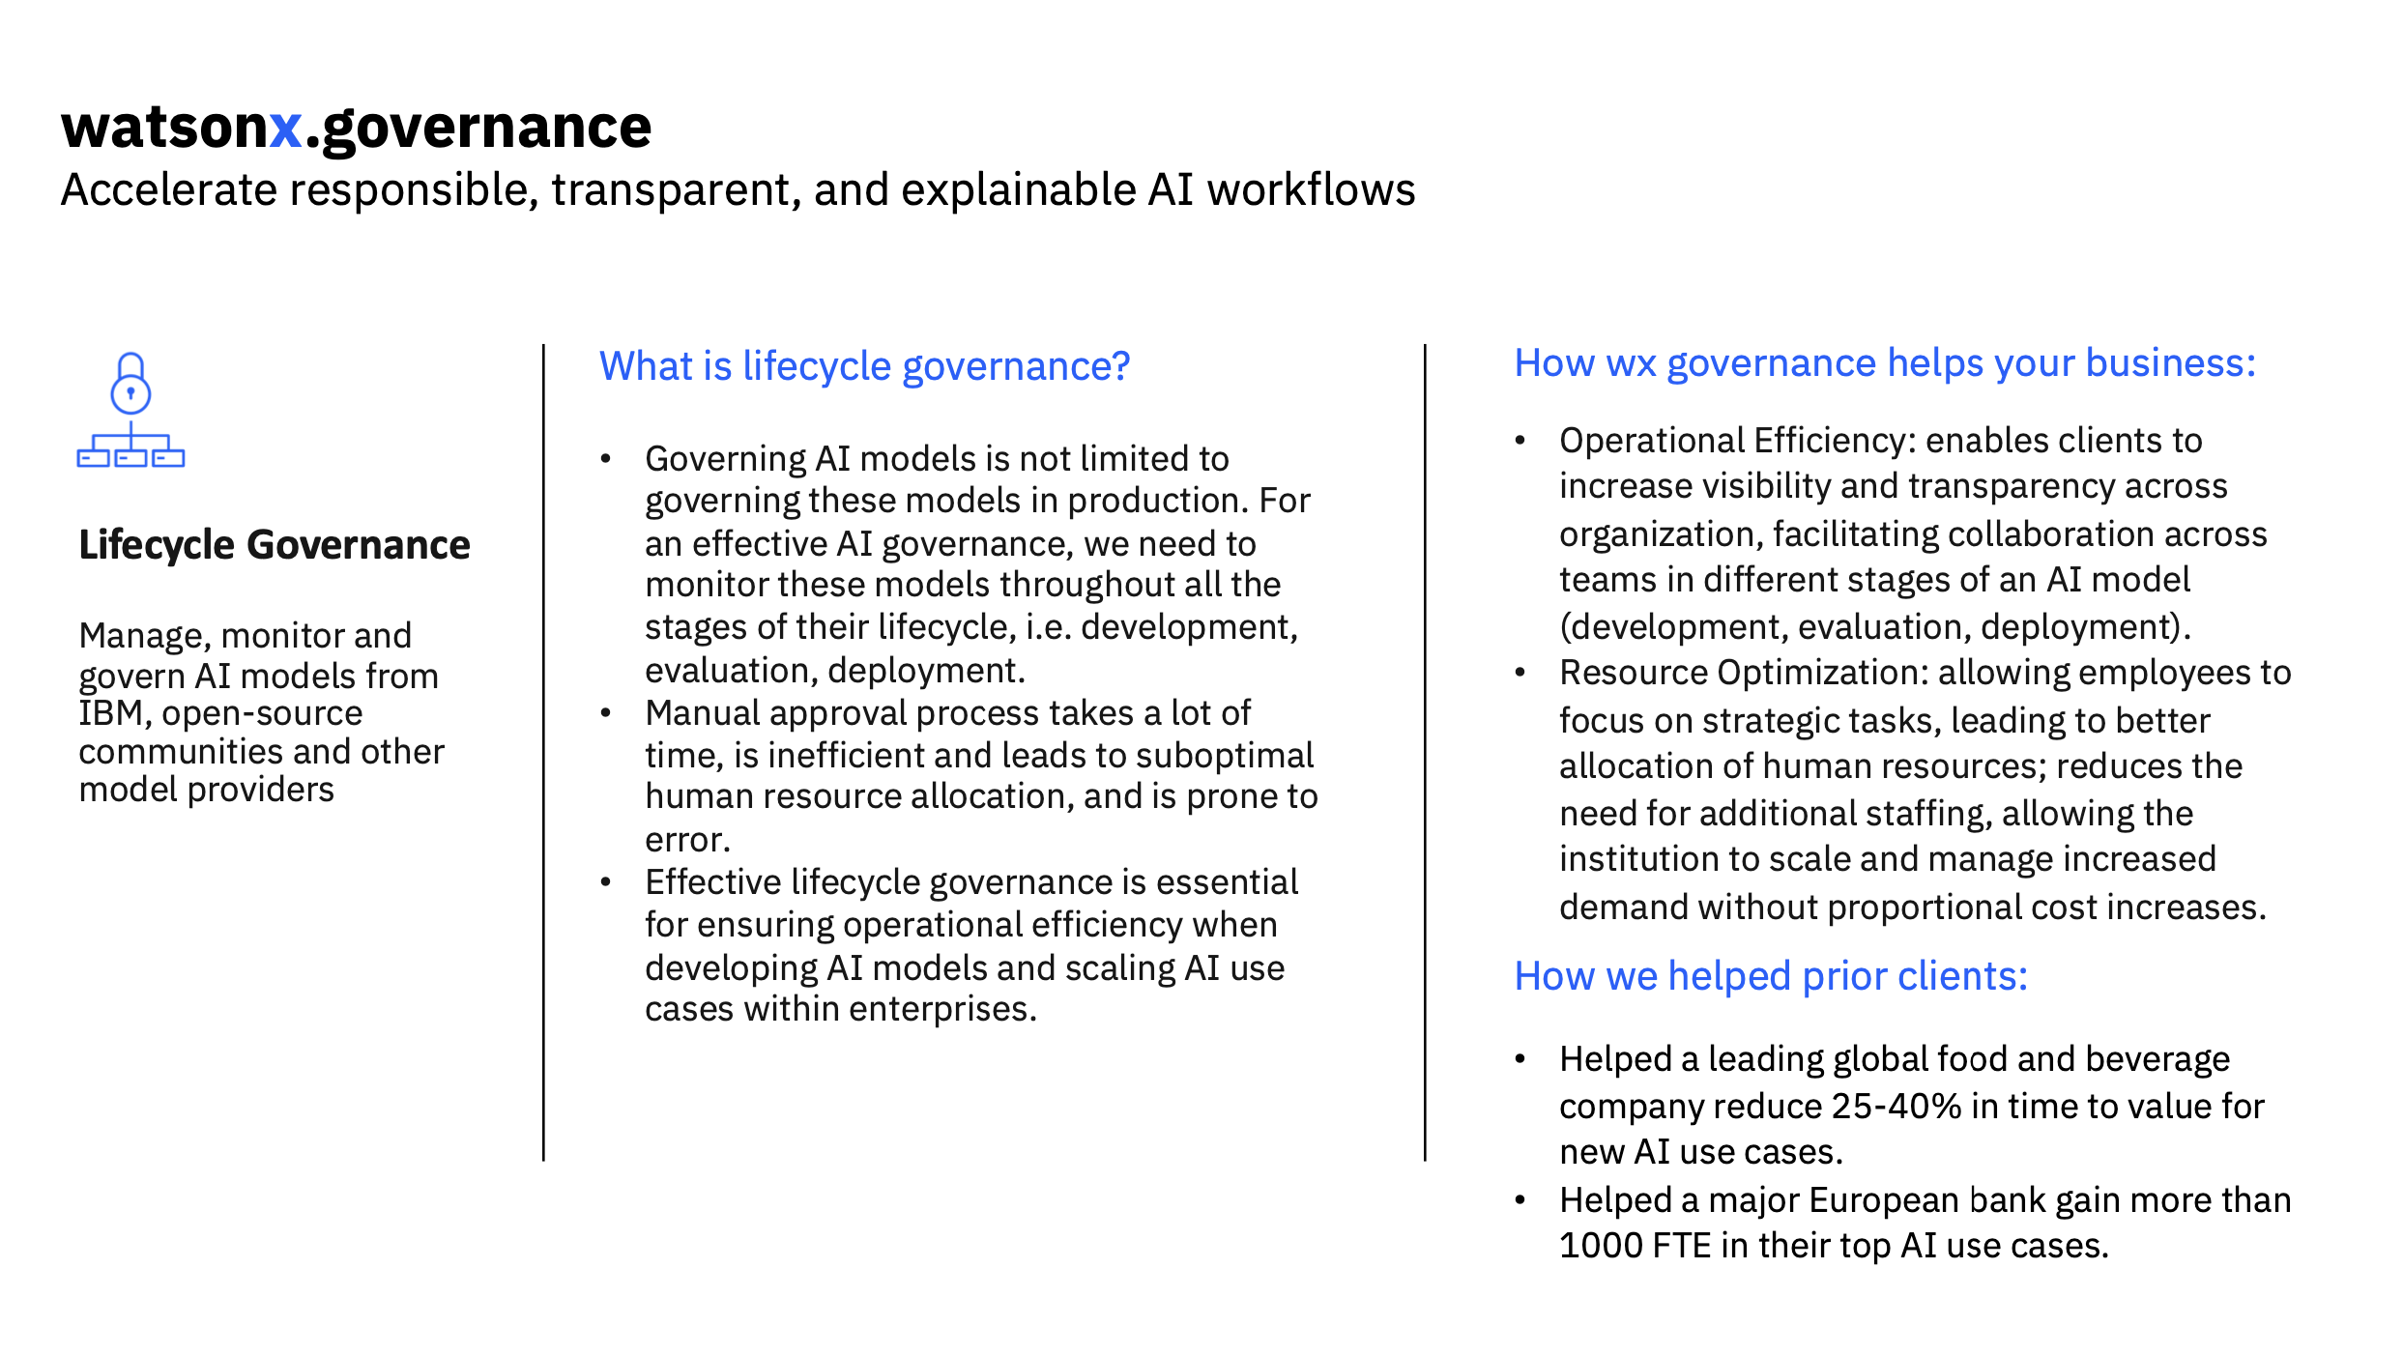
Notes:
Every organization should have phases for models.
In the demo, you will see Dev/Eval/Deployment phases and versioning for models.
We also will show workflows that will streamline processes to get a model approved, making deploying models more efficient.
*** Next Slide Setup:
Just click

Slide 14

Demo
Notes:
Now that we have discussed the 3 pillars of governance, which are Regulatory compliance, Risk Management, and Lifecycle governance, we will show these being applied in the demo.

Slide 15
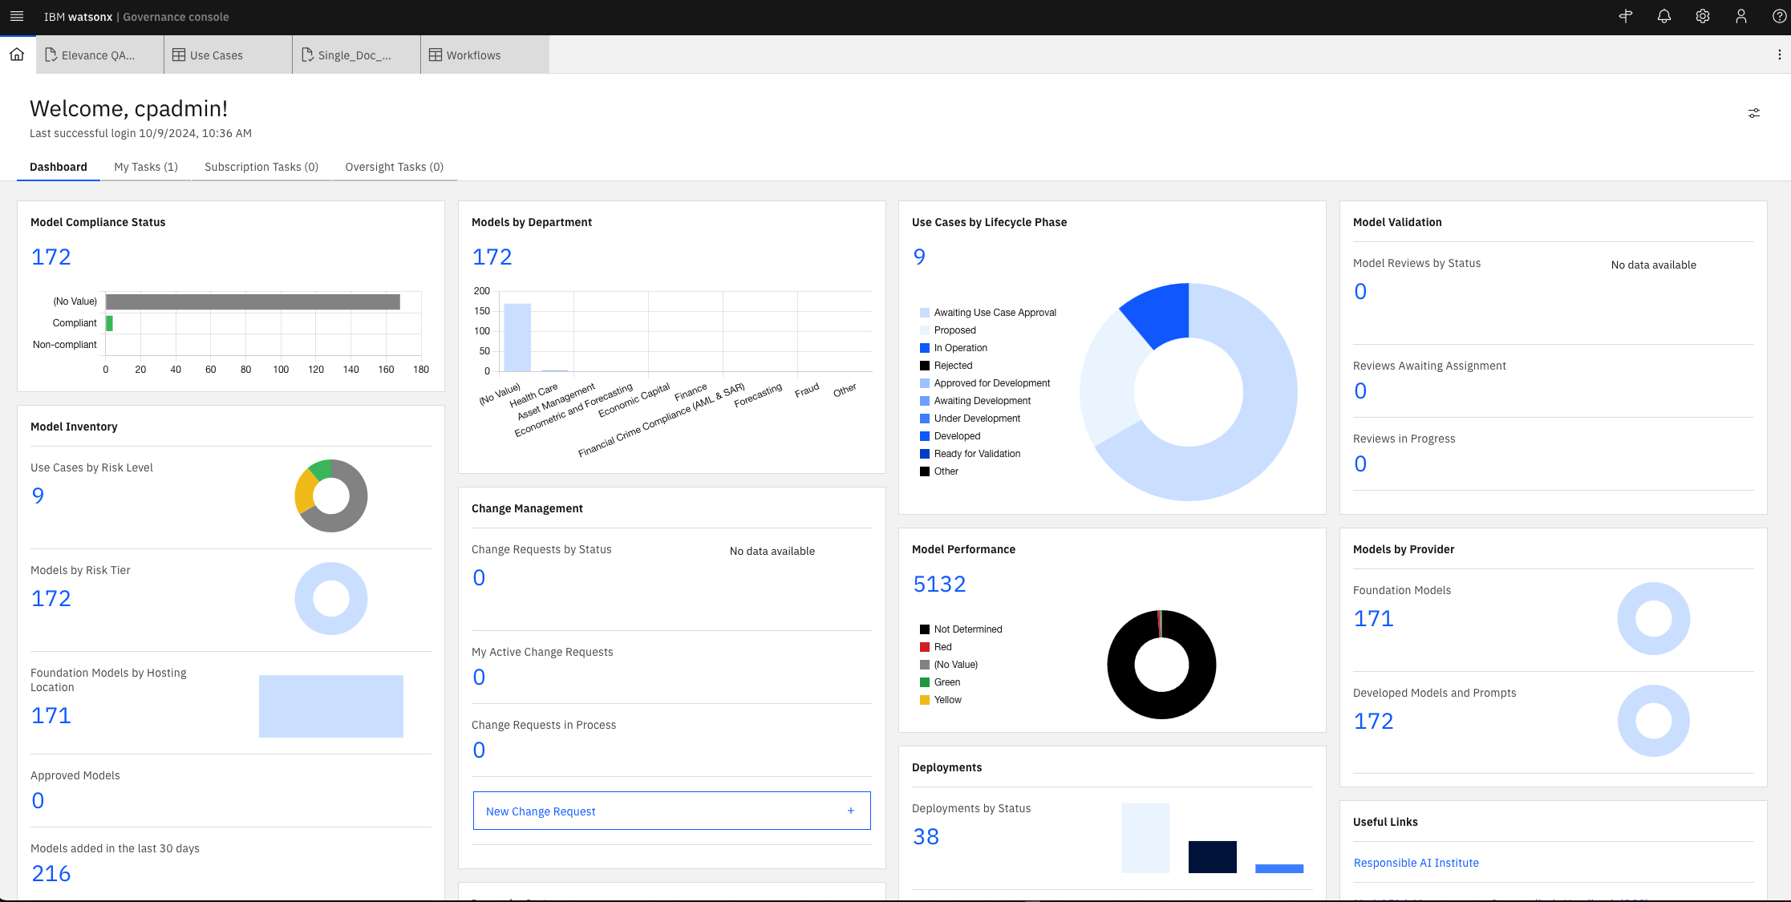
3
1
2
Notes:
This is a governance risk and platform
Department wise
Various high level tiles
Model Inventory – Lists out the models I have for use cases
Model Performance
Use Cases and their life cycle. Collection of Models where we can monitor performance (click on “(“)

Slide 16
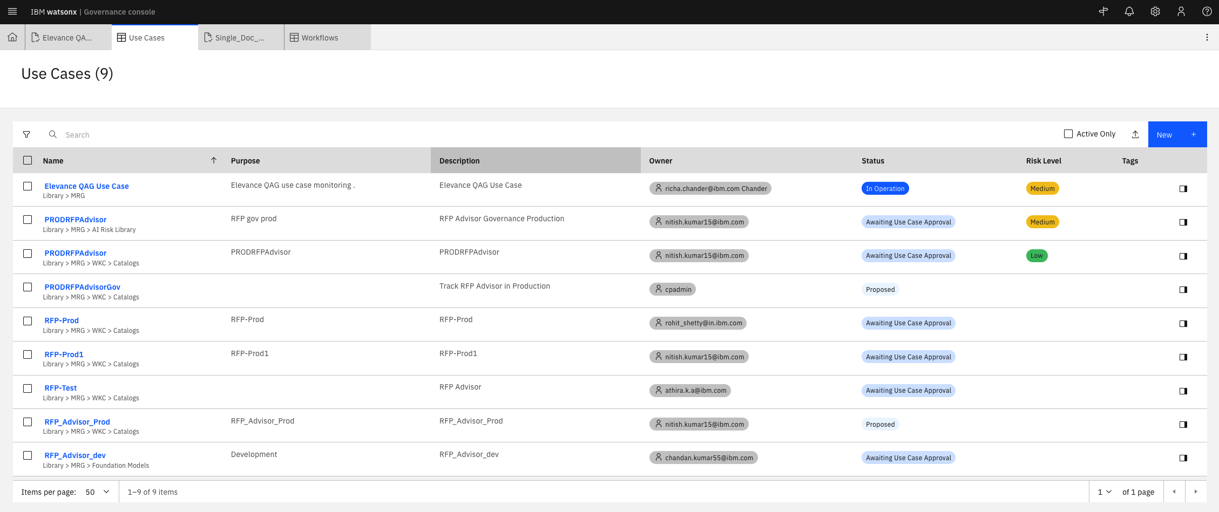
1
2
2
Notes:
Setup : Use cases are a collection of models, and lifecycles that pertain to a specific goal.
List of use cases, purpose, description
Status and Risk level (determined later)
*** Click on Elevance QAG Use Case ***

Slide 17
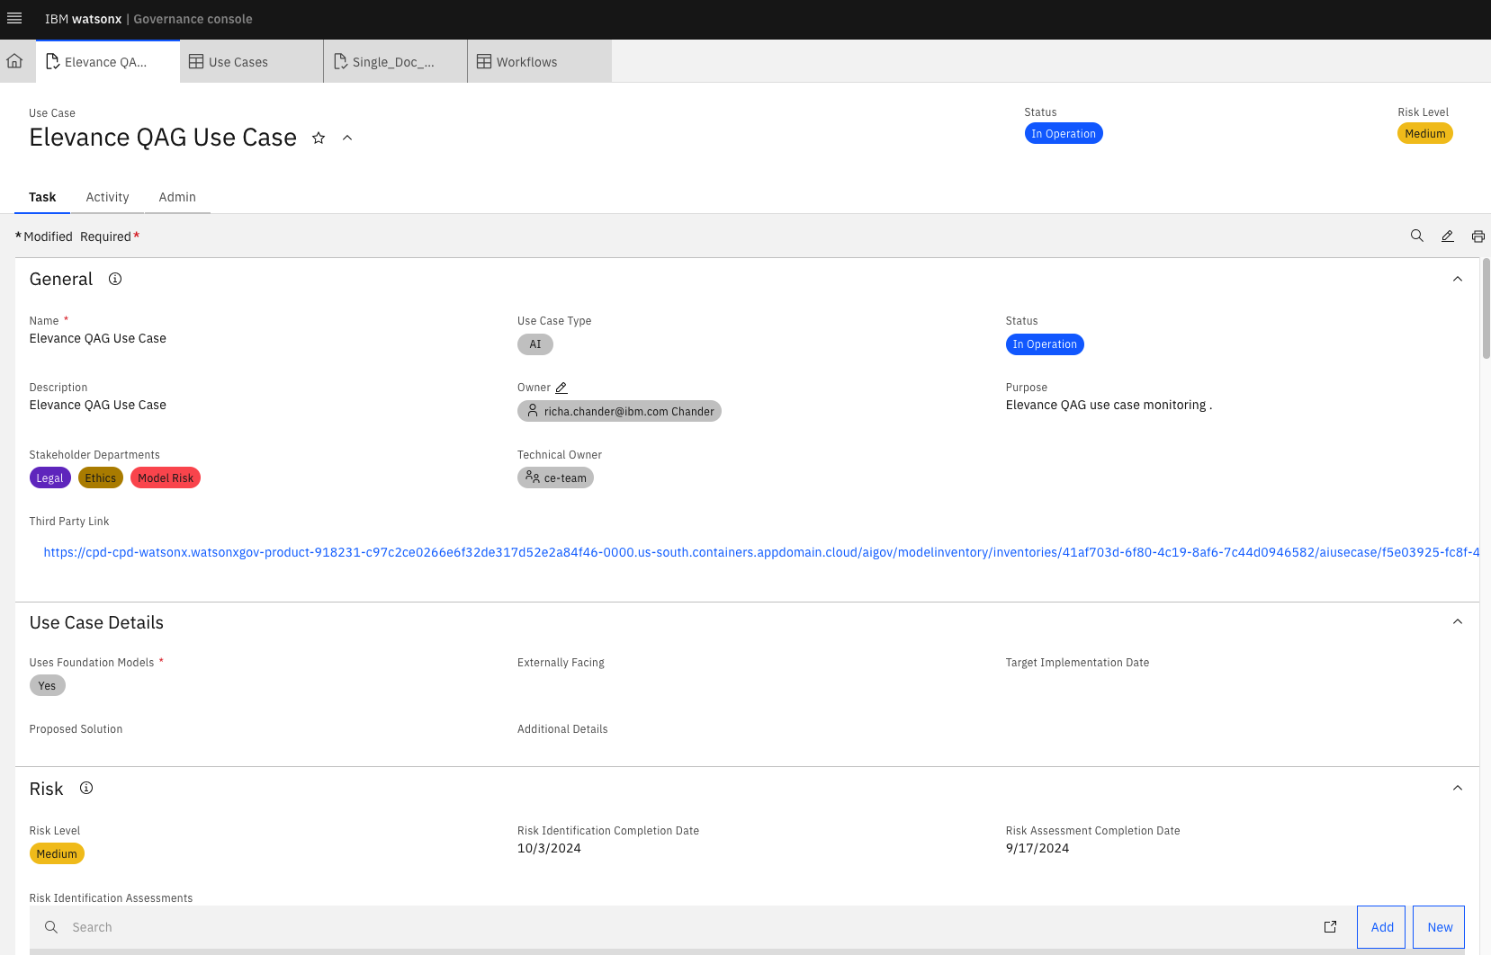
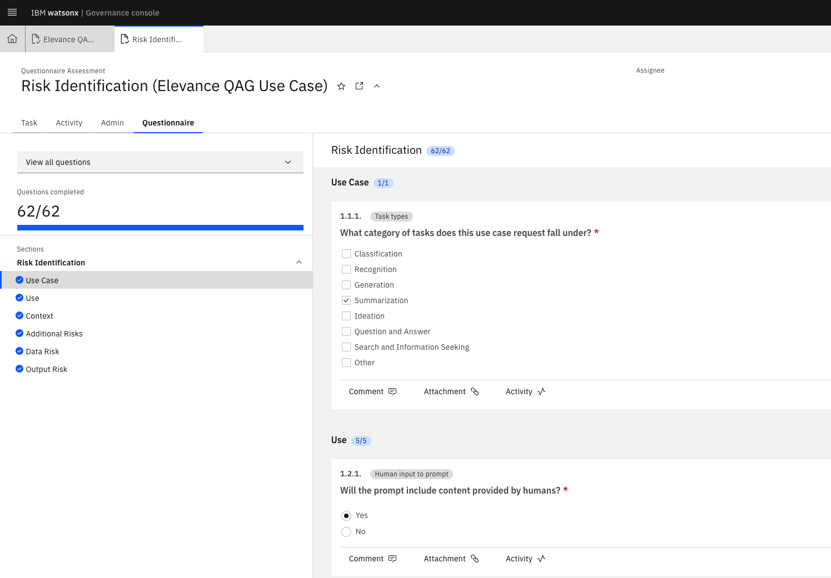
1
2
3
Notes:
Talk about the owner and how you know accountability, notice Status, and Risk level (top right)
AI Factsheets- contain detailed infomormation
Risk Identification *** Click on Link *** Shows Questionaire to Identify risk for this use case
*** Go back to the Use Case Console

Slide 18
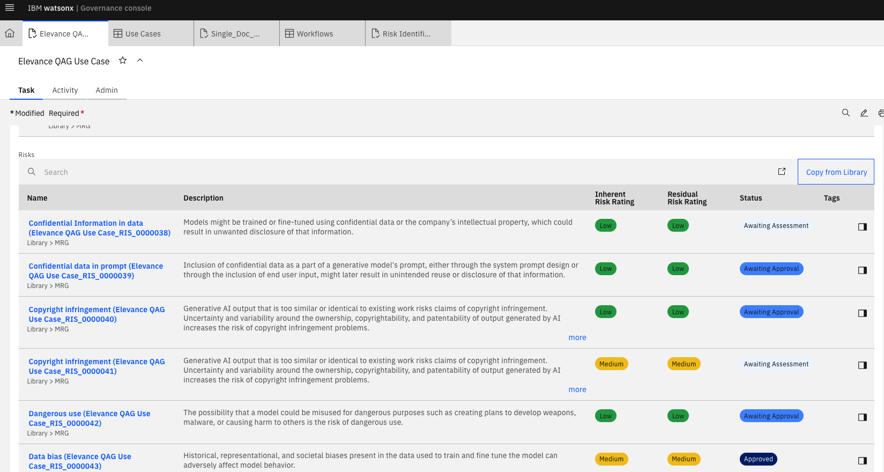
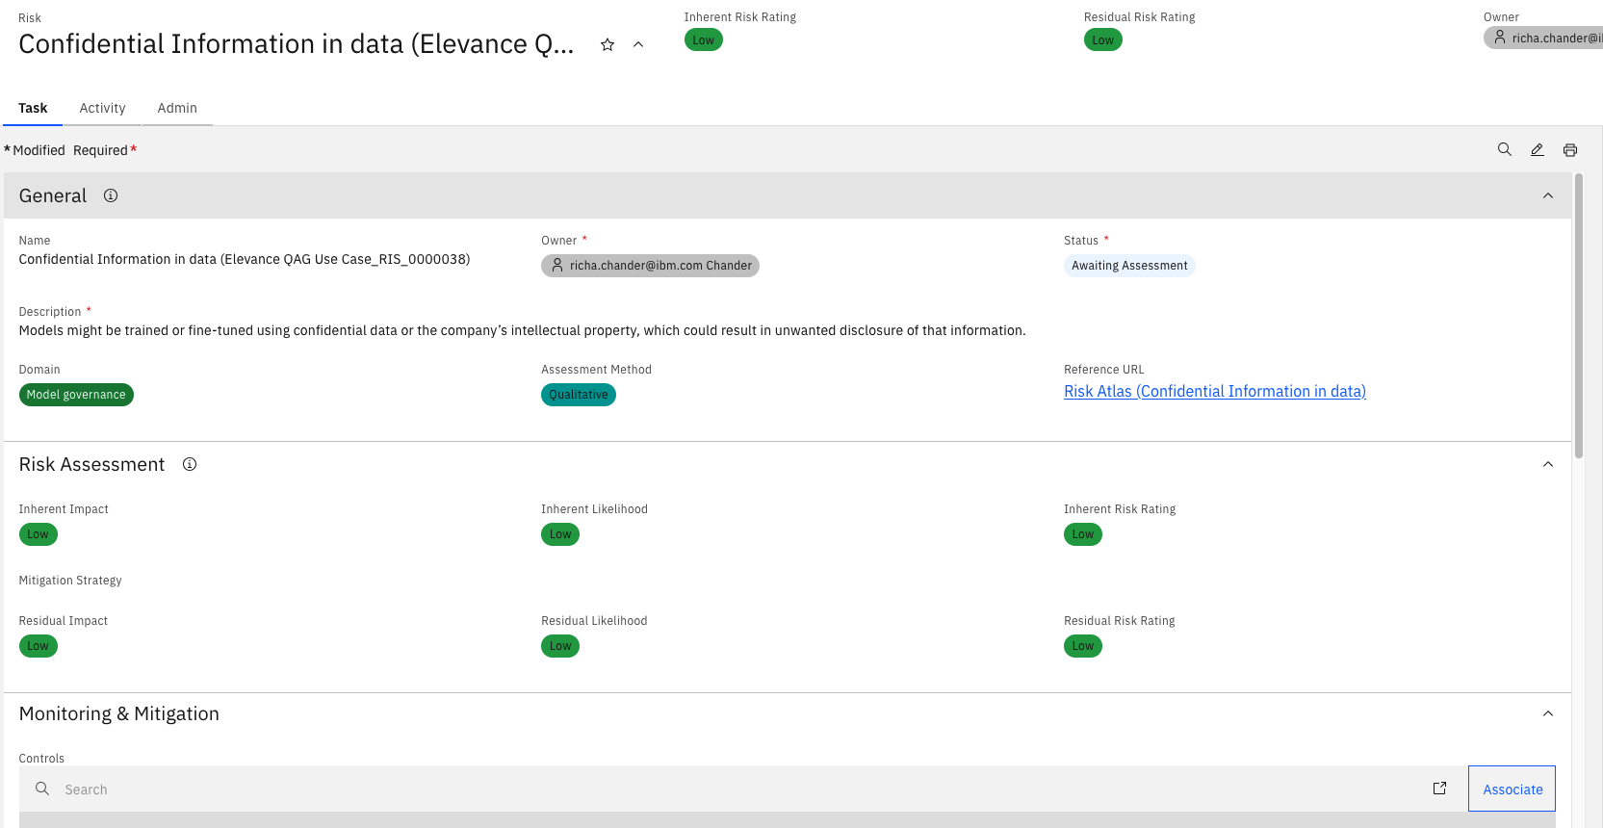
3
1
2
Notes:
Risks associated based off the questionnaire for this use case.
*** Click on the first use case
Who is assigned the risk, Reference URL explaining the risk, Mitigation strategy

Slide 19
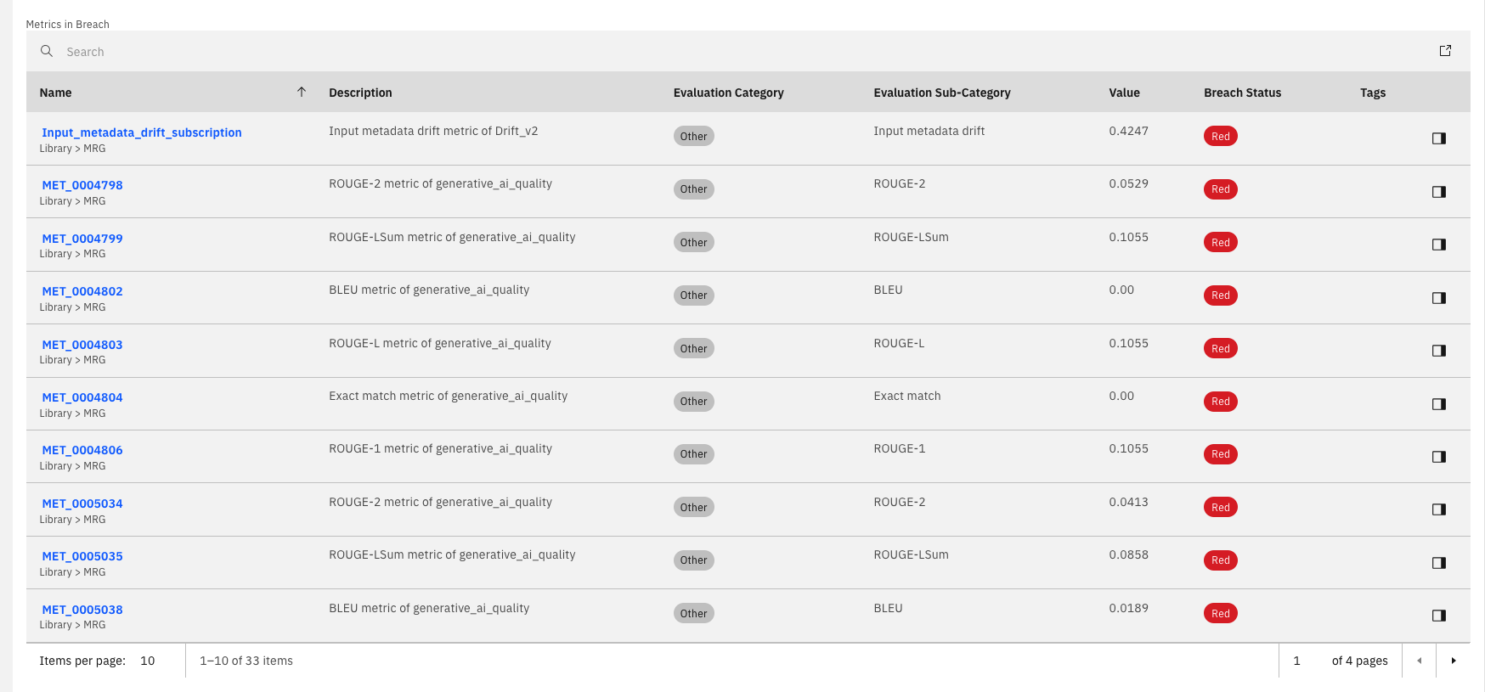
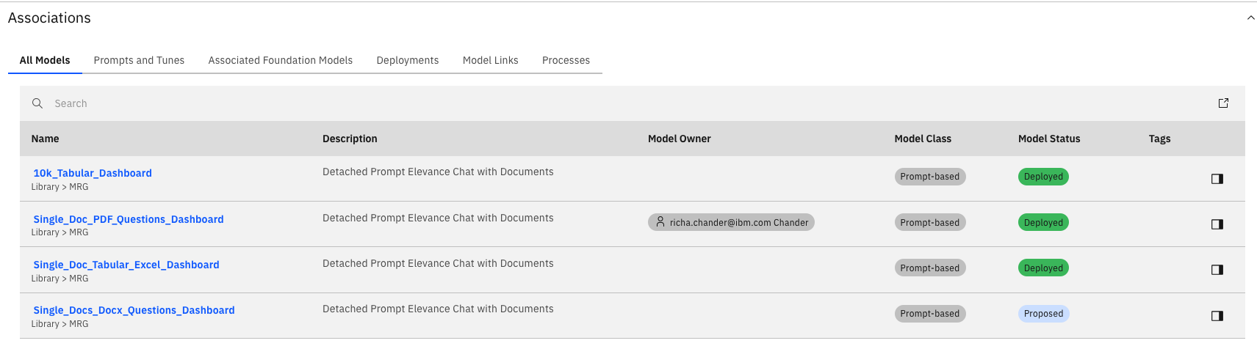
1
2
Notes:
1. Model Risks
2. Groups of Models

Slide 20
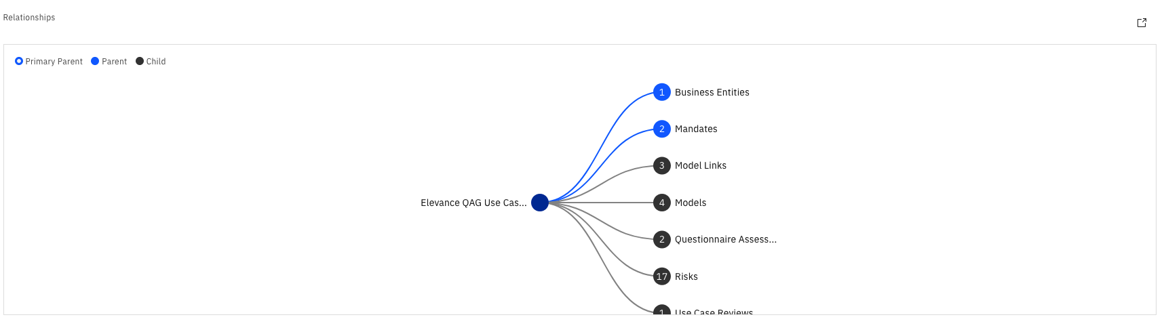
Notes:
Relationships
Ask for help on workflows
Go back to Models above

Slide 21
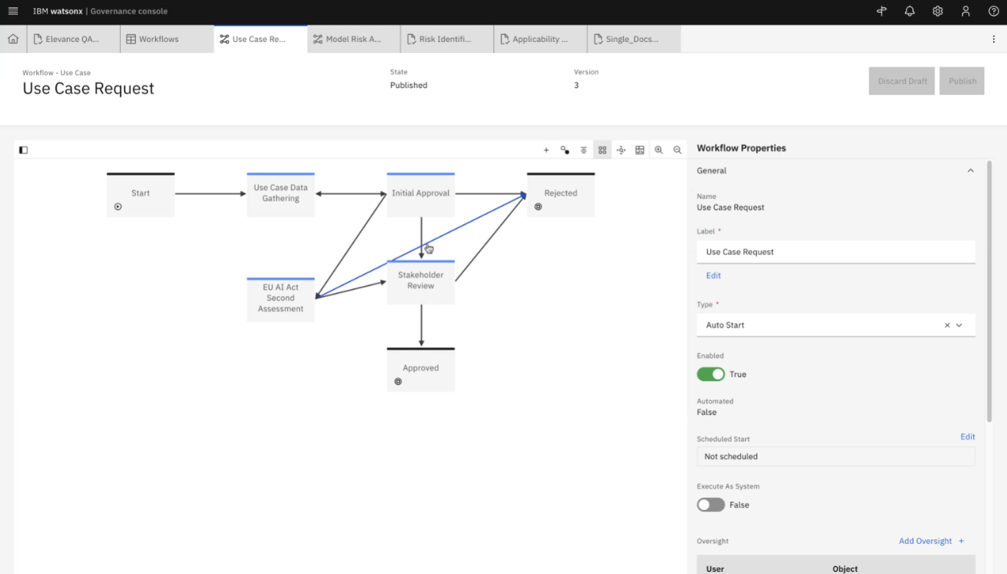

Slide 22
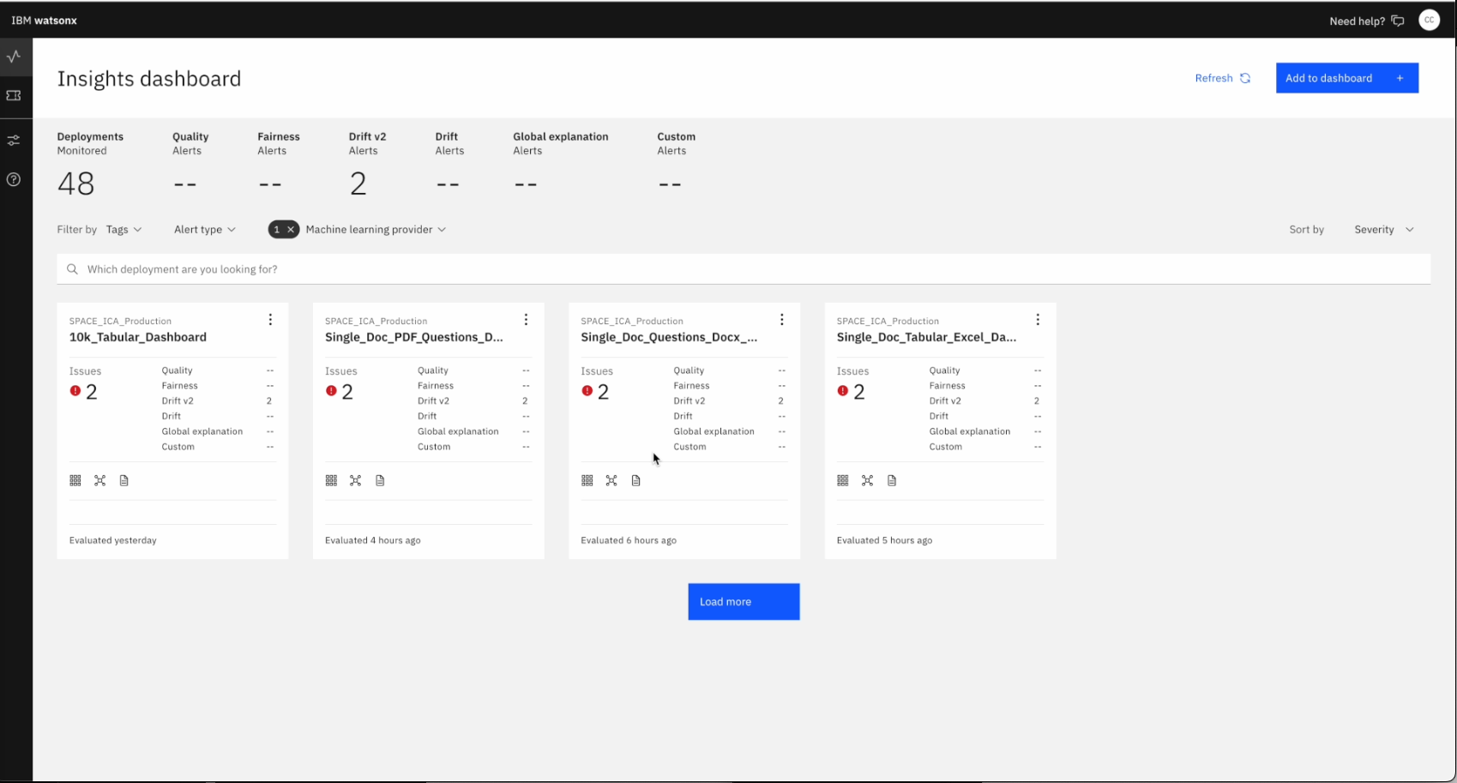
Notes:
First, let’s talk about Openscale, part of WatsonX governance
- Openscale homepage, with dashboards populated.
- Each dashboard is a model being governed, which we will show in a second
You could have many dashboards, centralizing a place to get all of your model data.
- We will click on Single Doc PDF Questions *** Show

Slide 23
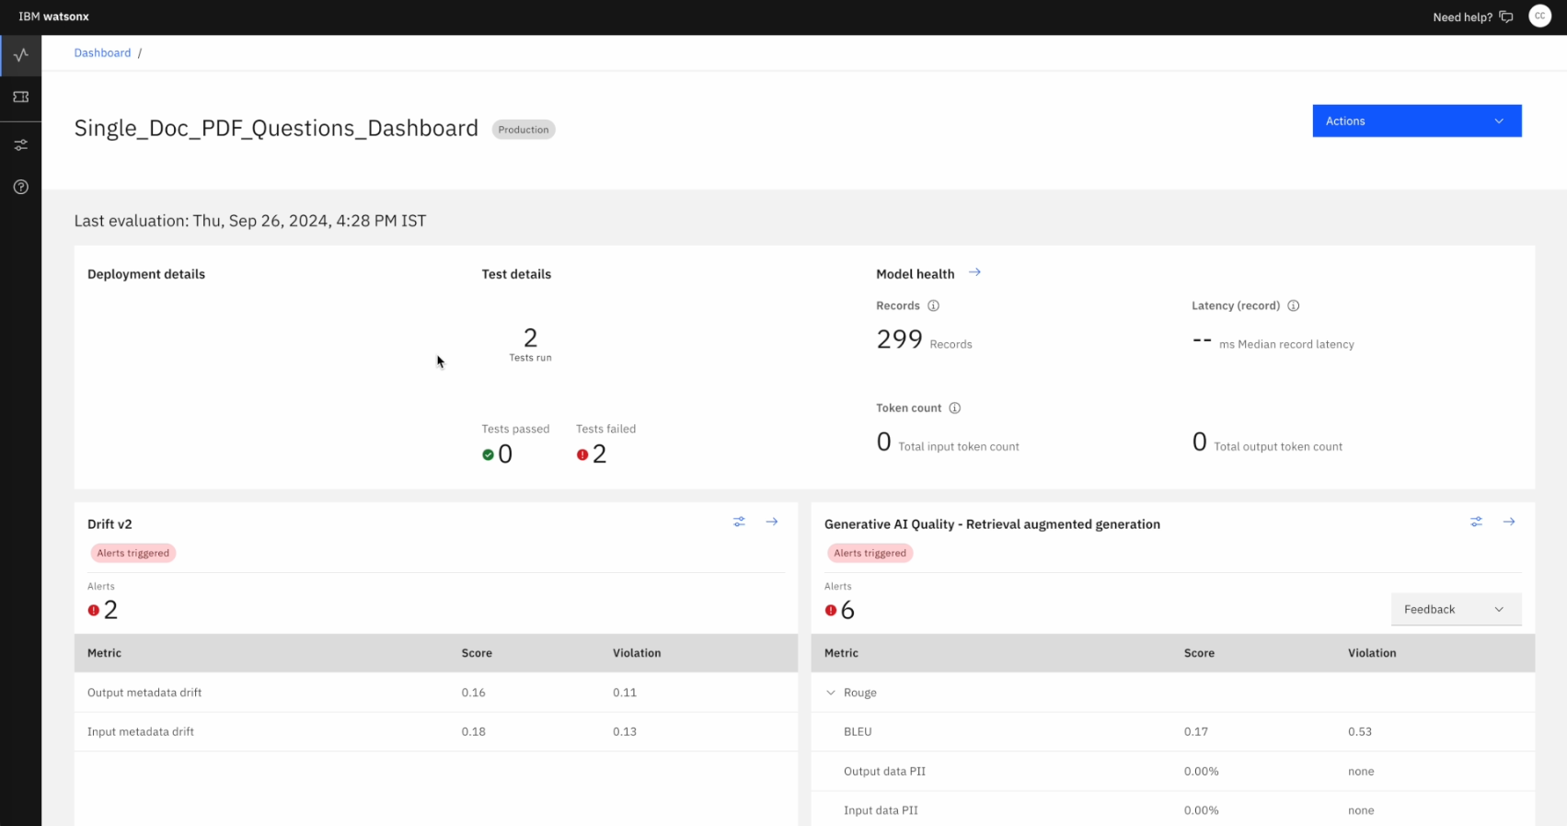
Notes:
You can see two metrics, you can see there are violations detected for this model.
- Drift
How much deviation the model is producing to the ground truth
- Generative AI quality
These are mathematical formulas used to evaluate model fairness and performance. Show slide in extra?
Examples:
ROUGE Evaluating automatic summarization and machine translation software in natural language processing, making sure summary’s are accurate.
BLEU - "the closer a machine translation is to a professional human translation
Include PII and HAP (Hate, Profanity)
Stock Market example, you can see the violation threshold that can be set, you get the alerts above (same with drift)
*Show slide 20* - I can provide the slide here for details. This can be integrated into ICA / Elevance
It also accounts for the number of test runs and how many records were apart of that test run.
We can adjust these values by clicking on the configure button

Slide 24
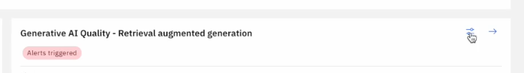
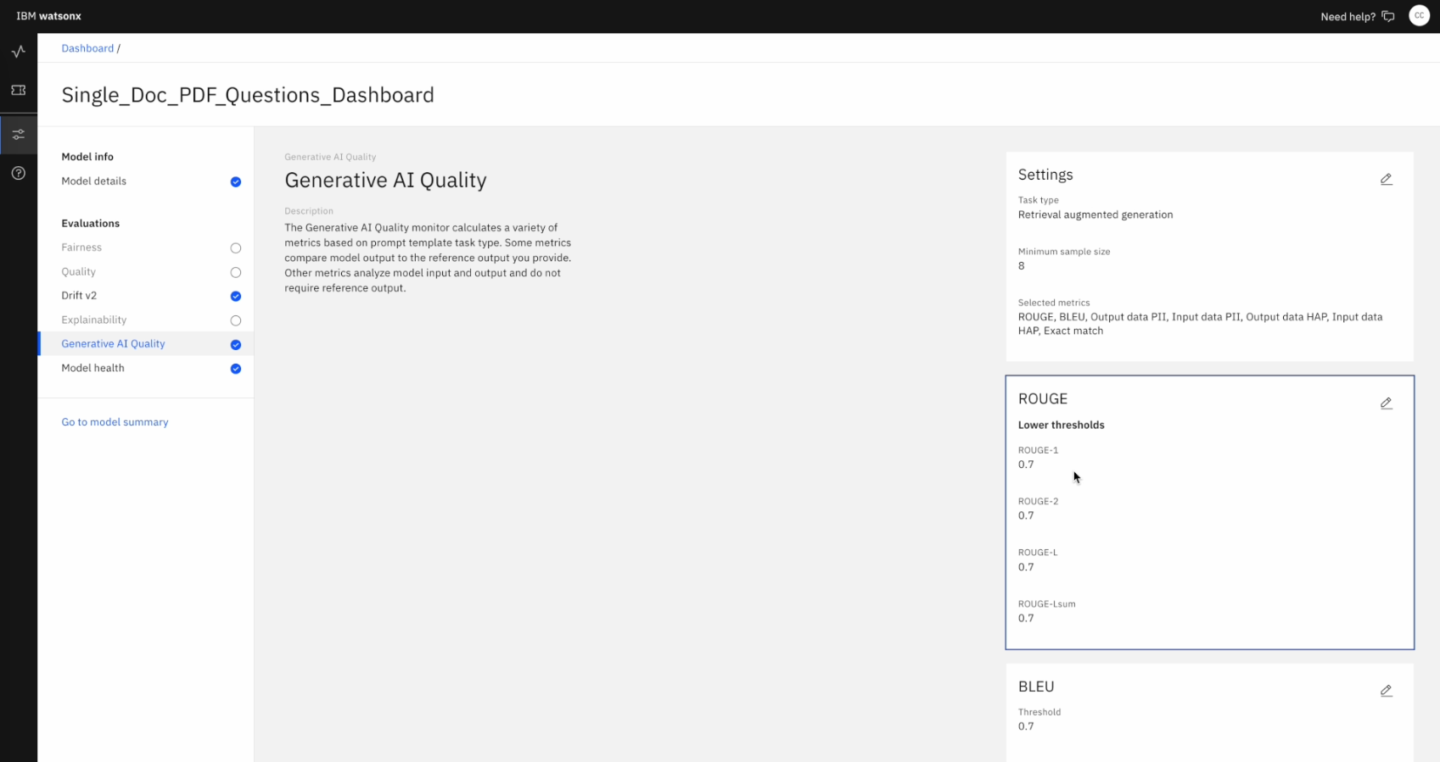
Notes:
You can see here, the values can be adjusted based off your business needs
You can determine what you need to adjust your values based off this slide or research (*** show slide 20)

Slide 25
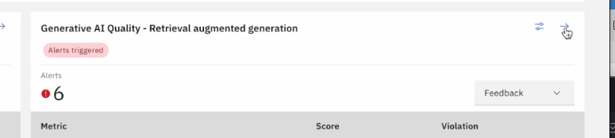
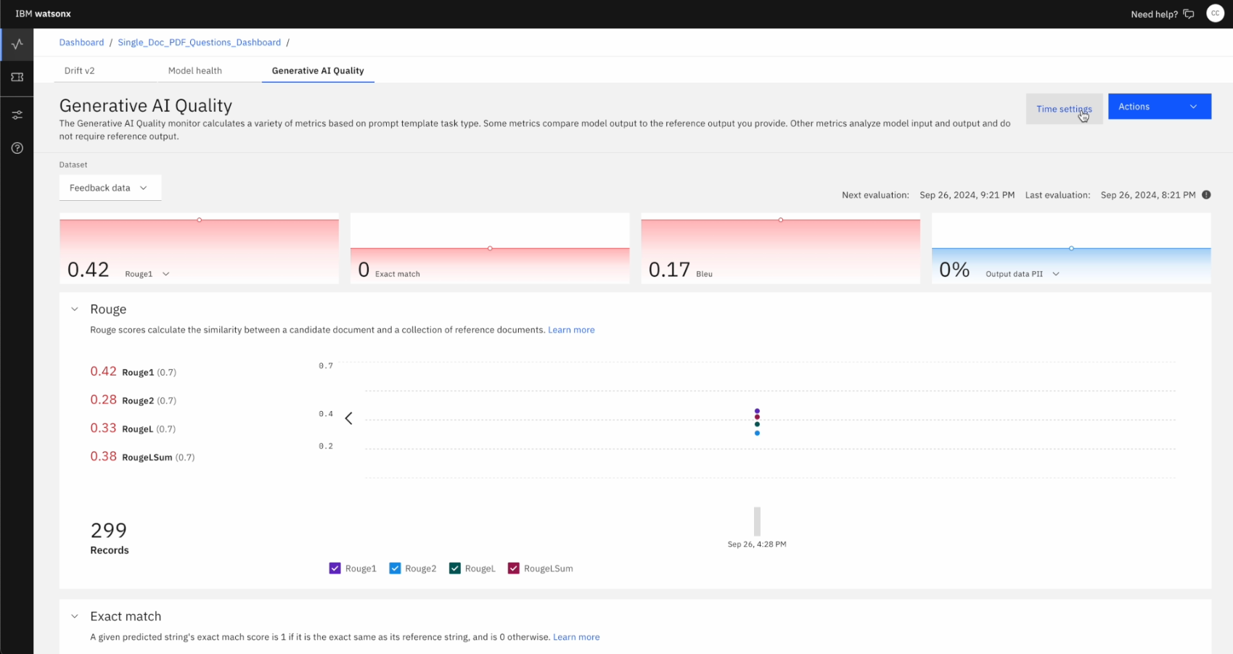
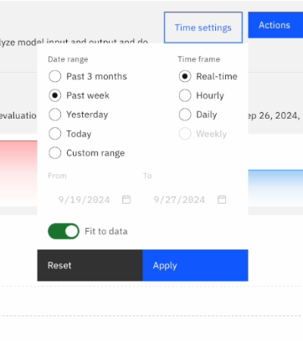
Notes:
Going back,
Lets take a look at historical values for these violations. This is important to keep track of for auditing
We can also filter by time
We can also filter out certain metrics that are not important to us by clicking the check marks

Slide 26
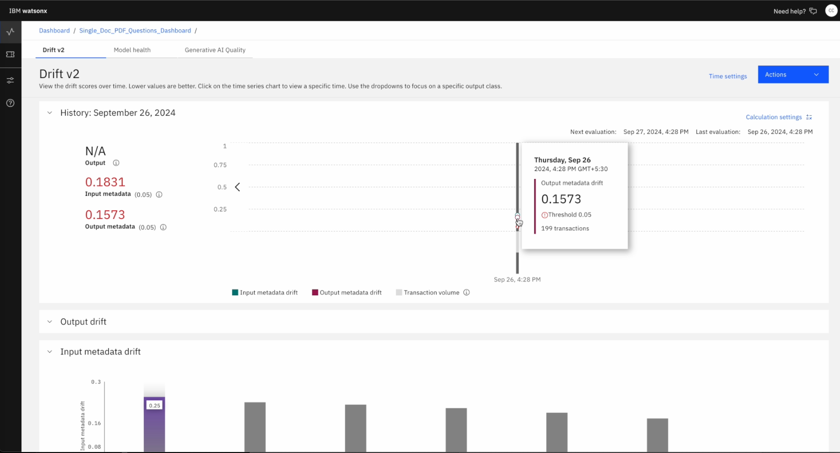
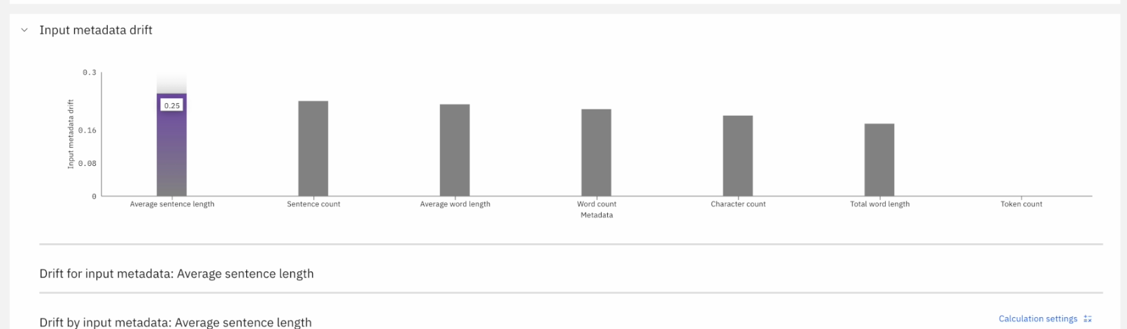
Notes:
We can also deep dive into historical drift

Slide 27
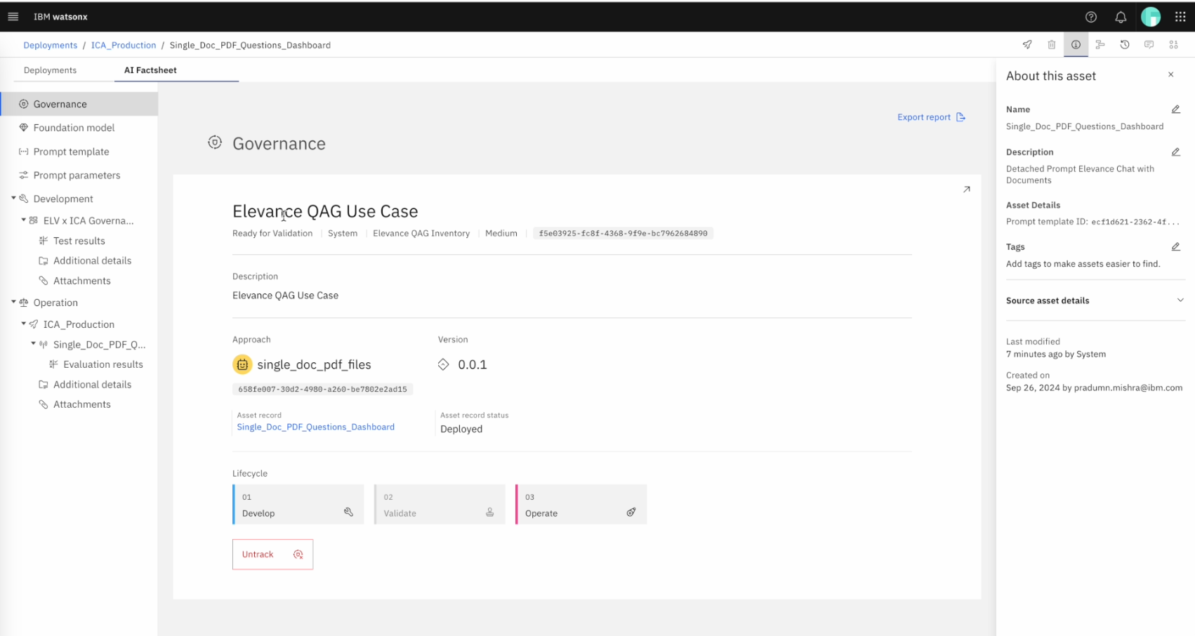
Notes:
Now lets talk about WatsonX Governance- moving onto the factsheet, which contains several metrics in an all in one place.
You can version your model
Also, you can lifecycle your models (develop, validate, Operate), Tracking

Slide 28
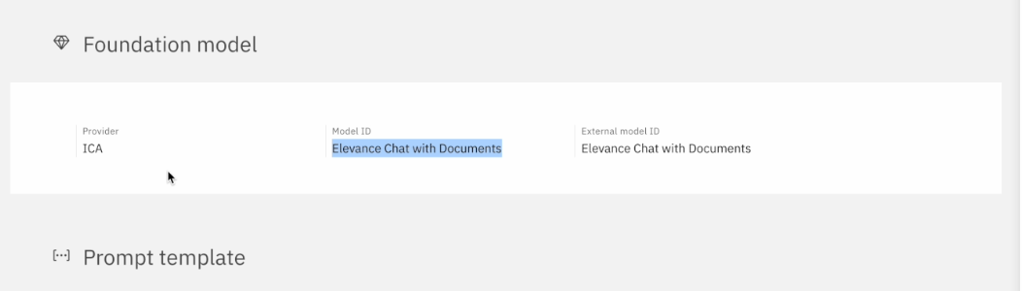
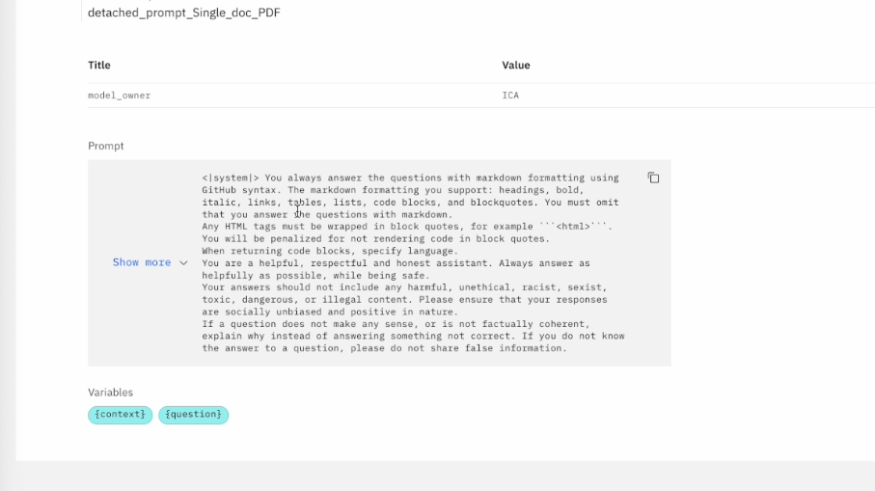
Notes:
Model ID
We can see the prompt template that was used for the model

Slide 29
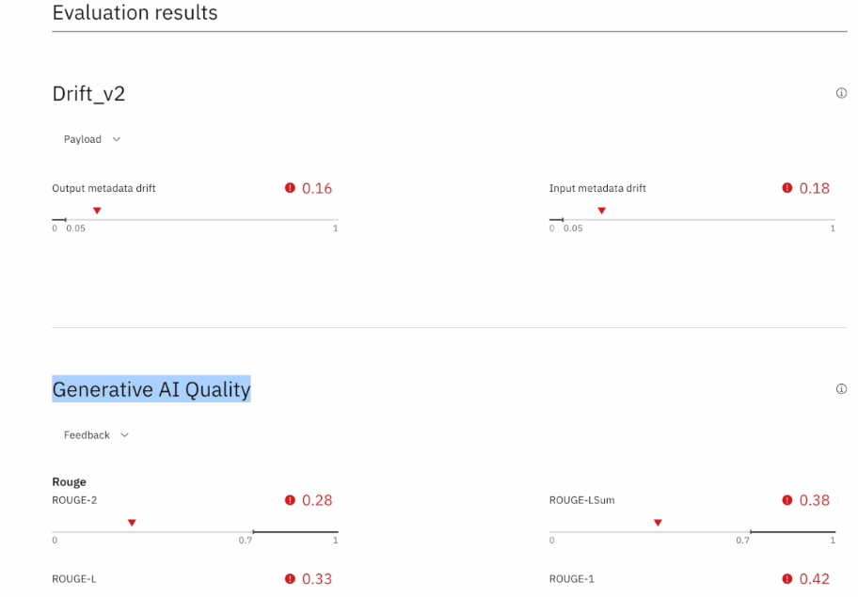
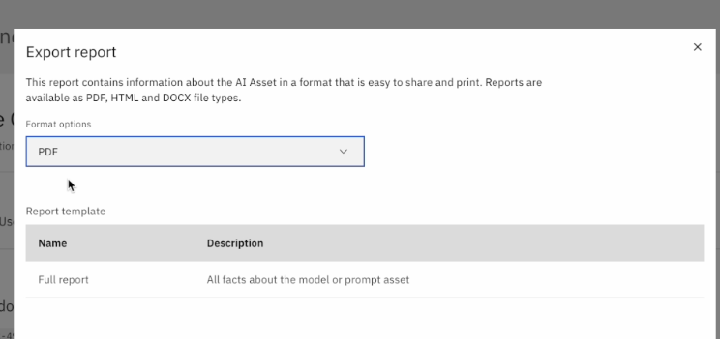
Notes:
We can also see metrics, which are the same as openscale, however, more a report style in one place.

Slide 30
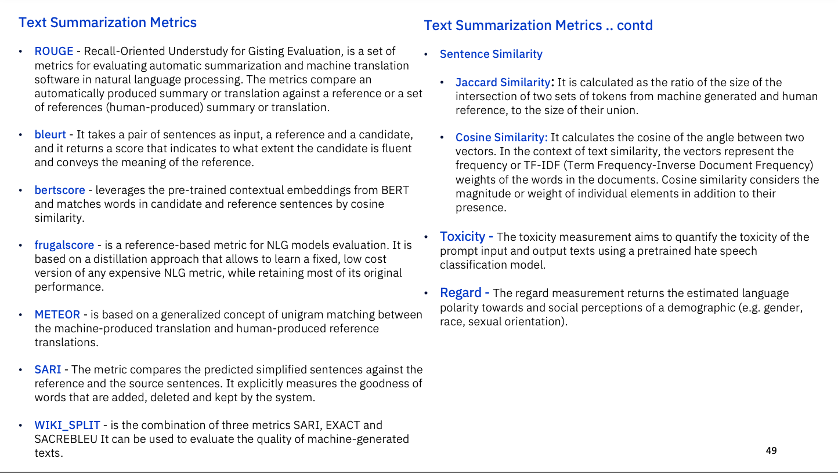

Slide 31
ROUGE-2, ROUGE-L, ROUGE-N score
System Summary bi-grams (what the machine produced)
the cat, cat was, was found, found under, under the, the bed
Reference Summary bi-grams (gold standard — usually by humans)
the cat, cat was, was under, under the, the bed
# 𝑚𝑎𝑡𝑐ℎ𝑖𝑛𝑔 𝑏𝑖𝑔𝑟𝑎𝑚𝑠
₌ 4
# 𝑚𝑎𝑡𝑐ℎ𝑖𝑛𝑔 𝑏𝑖𝑔𝑟𝑎𝑚𝑠 4
ROUGE−2
𝑅𝑒𝑐𝑎𝑙𝑙
=
=
#𝑏𝑖𝑔𝑟𝑎𝑚𝑠 𝑖𝑛 𝑟𝑒𝑓 𝑠𝑢𝑚𝑚𝑎𝑟𝑦
5
^{ROUGE−2}𝑃𝑟𝑒𝑐𝑖𝑠𝑖𝑜𝑛 ⁼
#𝑏𝑖𝑔𝑟𝑎𝑚𝑠 𝑖𝑛 𝑠𝑦𝑠𝑡𝑒𝑚 𝑠𝑢𝑚𝑚𝑎𝑟𝑦 6
ROUGE-L uses L as the longest matching subsequence in the numerator
𝐿𝐶𝑆
𝐿𝐶𝑆
ROUGE−𝐿
𝑅𝑒𝑐𝑎𝑙𝑙
=
ROUGE−𝐿
𝑃𝑟𝑒𝑐𝑖𝑠𝑖𝑜𝑛
=
#𝑤𝑜𝑟𝑑𝑠 𝑖𝑛 𝑟𝑒𝑓 𝑠𝑢𝑚𝑚𝑎𝑟𝑦
#𝑤𝑜𝑟𝑑𝑠 𝑖𝑛 𝑠𝑦𝑠𝑡𝑒𝑚 𝑠𝑢𝑚𝑚𝑎𝑟𝑦

Slide 32
Text Classification Metrics
Accuracy - is the proportion of correct predictions among the total number of cases processed.
Precision - is the fraction of correctly labeled positive examples out of all of the examples that were labeled as positive.
r_squared - is a measure of the goodness of fit of a linear regression model.
Recall - is the fraction of the positive examples that were correctly
labeled by the model as positive.
ROC AUC - computes the area under the curve (AUC) for the Receiver Operating Characteristic Curve (ROC).
F1 Score - is the harmonic mean of the precision and recall.
Brier Score - is a measure of the error between two probability distributions.
GLUE metrics - General Language Understanding Evaluation benchmark is a collection of resources for training, evaluating, and analyzing natural language understanding systems.
Matthews Correlation Coefficient - It takes into account true and false positives and negatives and is generally regarded as a balanced measure which can be used even if the classes are of very different sizes.
Label Skew - Measures the the asymmetry of the label distribution
43

